Slide 1
Using Text Mining Tools to Analyze Descriptions of Welcoming Spaces as Experienced by People with Serious Mental Illnesses
Eugene Brusilovskiy, Gretchen Snethen, Bryan McCormick, Mark S. Salzer
The contents of this presentation were developed under grants from the National Institute on Disability, Independent Living and Rehabilitation Research (NIDILRR; Grant # 90RT5021-02-00; Salzer, PI). However, the contents do not necessarily represent the policy of the U.S. Department of Health and Human Services, and endorsement by the Federal government should not be assumed.

Slide 2
Background: Welcoming Spaces
Individuals with serious mental illnesses (SMI) often face barriers to community participation, which involve feeling stigmatized and “othered”
Welcoming spaces are those that make individuals feel safe and secure, accepted, empowered, calm, connected, validated, hopeful, physically and psychologically comfortable, respected and motivated.
They can be places of worship, stores, cafes, gyms, or any other place in the community.

Slide 3
Background: Perceptions of Welcoming Spaces
Greater perceptions of welcoming spaces could mean that these spaces are more likely to serve as pillars of support, avenues for social connection, and catalysts for positive behaviors, all of which play a role in greater well-being, greater perceived recovery, and lower loneliness.
Individuals who describe their welcoming spaces more positively may be more likely to experience a greater sense of belonging, more supportive social interactions, reduced stigma, and greater validation there, which is crucial for mental well-being.
Similarly, a more positive description of a welcoming space may indicate greater distal supports, reflecting an inclusive, resourceful, and supportive environment that fosters social connections, reduces stigma, and promotes civic engagement.
Greater perceptions of the most positive space may also enhance the number of spaces an individual finds to be welcoming, because having one space viewed very positively can give the individual greater skills, coping mechanisms and confidence to go to and feel welcome at other locations in the community.

Slide 4
Background: Sentiment Analysis
Sentiment Analysis is a sub-field of Natural Language Processing (NLP) that aims to determine the sentiment or emotion expressed in a piece of text. It can categorize sentiments as positive, negative, or neutral based on textual content.
It has applications in customer feedback analysis, social media monitoring, market research, and academic research
Techniques:
Lexicon-based Methods: These methods use predefined lists of words with associated sentiment scores to determine the overall sentiment of the text.
Machine Learning Methods: Machine learning models can be trained on labeled sentiment data to learn and predict sentiment on new, unlabeled data.
Deep Learning Methods: Advanced techniques like neural networks and recurrent neural networks can capture complex sentiment relationships in text data.
Challenges:
Sarcasm and Ambiguity: Detecting sarcasm and resolving ambiguity in text are significant challenges in sentiment analysis.
Context Sensitivity: Sentiment can heavily depend on context, and missing or misinterpreting context can lead to inaccurate sentiment scoring.
Language Variations: Differences in language, dialects, and expressions across different regions and cultures can complicate sentiment analysis.
Various tools and packages are available for sentiment analysis, including R packages like tm, SentimentAnalysis, sentimentr, and tidytext.

Slide 5
Study Aims
In this study, we will use sentiment analysis for analyzing descriptions of individuals’ most welcoming space.
We expect that descriptions of welcoming spaces will be overall positive – that is, participants will use mostly positive words to describe their most welcoming space.
However, we expect that the sentiment scores of these descriptions will vary across participants
We will examine whether higher sentiment scores are associated with:
Greater well-being/flourishing
Lower loneliness
Greater perceived recovery
More distal supports
More welcoming spaces
We will also examine whether these associations are stronger for individuals who provide longer descriptions of their most welcoming space.
While a short text might be ambiguous, leading to misinterpretation, longer texts typically provide more context and nuance, and greater richness and density of information. (Hartmann et al., 2023).
Furthermore, longer documents are likely to contain more sentiment signals than a single sentence. For instance, Hartmann et al. (2019) found that analyzing brief Amazon review titles yielded more errors compared to full-length reviews.

Slide 6
Participants
Using a survey approach, 84 individuals were recruited for a study in which they were asked to identify and describe locations where they felt welcome as someone with a mental illness.
Participants were recruited from four mental health centers in urban and suburban neighborhoods
Eligibility criteria for participants in the study included:
Having a diagnosis of major depression, bipolar disorder I or II, or a schizophrenia spectrum disorder
Identifying as having a mental illness
18 years or older
Being able to identify a welcoming place in the community
Individuals with legal guardians or who could not otherwise provide consent were excluded.
90 individuals enrolled and 84 had valid data that were included in the analyses

Slide 7
Measures
We collected information on demographics and several quantitative measures:
Total number of places where individuals felt welcome
Total number of distal supports
Recovery Assessment Scale (Giffort et al., 1995; Corrigan et al., 2004)
Higher scores = greater perceived recovery
Flourishing Scale (Diener et al., 2009)
Higher scores = greater well-being
UCLA Loneliness Scale (Russell et al., 1980; Russell, 1996)
Higher scores = greater loneliness

Slide 8
Measures (Cont’d)
We also conducted structured qualitative interviews that asked participants about:
Their interactions and feelings in various community spaces like grocery stores, pharmacies, restaurants, and places of worship;
Descriptions of characteristics of places where they feel most welcomed and comfortable.
Interviews were recorded and transcribed

Slide 9
Qualitative Data Cleaning
Transcribed qualitative interviews, saved as Word files, were imported into R
Relevant sections of the interview (describing the most welcoming space) were kept
The following text cleaning steps were taken using the tm package in R:
We removed everything said by the interviewer, and only kept the responses from the participant
We changed everything to lower case
We transformed two-word negative expressions into a single word that encapsulates the intended antonym (e.g., changed “not like” to “dislike”, “not happy” to “unhappy”, etc.)
We applied lemmatization to our data, which groups together different inflected forms of the same word ("am", "is", "are", "was", and "were" all become "be").
We removed numbers, special characters ($, @, #, /, etc.), and punctuation
We removed English stop words (words that don’t add much to the substance), such as articles and prepositions
We removed additional stop words (e.g., “participant”, “also”, “every”)

Slide 10
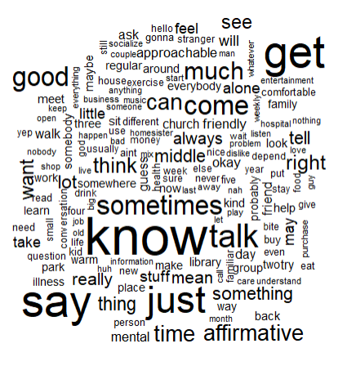
Word Cloud
We created a word cloud to show the common words that appear in the responses (minimum word frequency = 25) using the wordcloud package in R.
Larger font corresponds to greater word frequency.

Slide 11
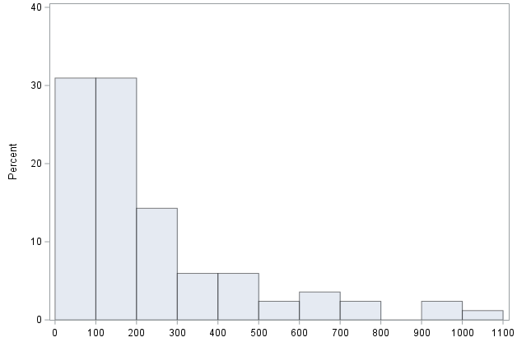
Response Length
After data cleaning, the average document had 231.5 words (SD=222.5). The range was between 2 and 1032 words, with a median of 158.

Slide 12
Sentiment Analysis
Lexicon-based sentiment analysis was conducted using the syuzhet package in R using three lexicons:
AFINN (Author: Finn Årup Nielsen)
Structure: The AFINN lexicon assigns words with an integer score between -5 (most negative) and +5 (most positive) based on their sentiment. The score provides a finer grain measure of sentiment than simple positive/negative categorization.
Coverage: Contains only around 2,500 words
Usage: Commonly used for Twitter sentiment analysis due to its simplicity and ease of use.
Bing (Liu) Lexicon (Author: Bing Liu):
Structure: This lexicon classifies words into binary categories: positive or negative.
Coverage: Has a larger coverage compared to AFINN but might not be as extensive as some others.
Usage: Suitable for basic sentiment analysis tasks where a fine-grained sentiment score isn't required.
Syuzhet (Developed as part of the syuzhet package in R by Jockers)
Structure: Like Bing, the Syuzhet lexicon provides binary sentiment scores (positive or negative).
Coverage: Contains a curated list of words meant to capture the narrative arc in texts
Usage: Designed for analyzing sentiment variation across narrative plots but can be used for general sentiment analysis too.

Slide 13
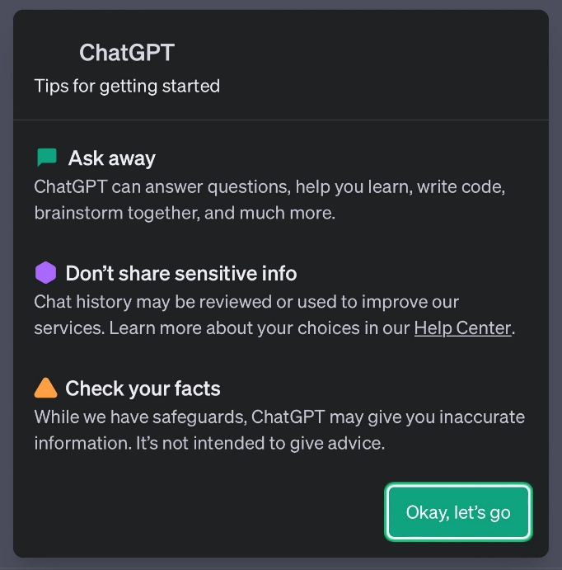
Using ChatGPT
We initially wanted to use ChatGPT to summarize participant responses
Even though interviews were deidentified, we had concerns about participant privacy

Slide 14
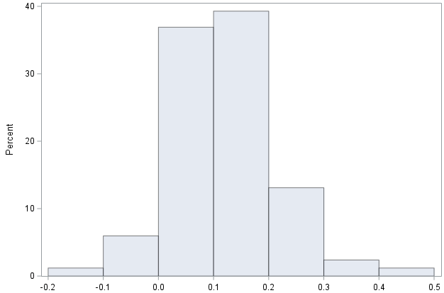
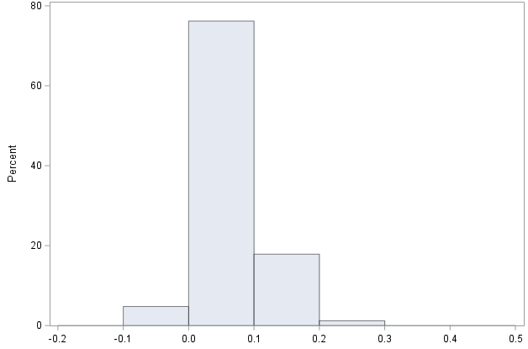
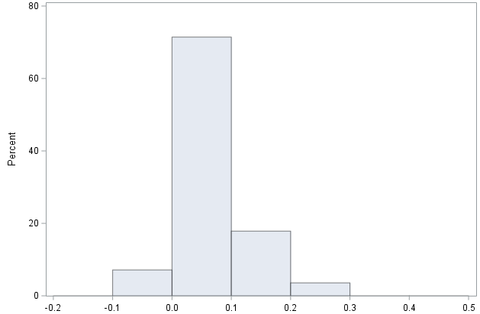
Sentiment Analysis (Cont’d)
We calculated the average sentiment score of all the terms in each individual’s (cleaned) description of the place where they felt most welcome using the AFINN, Syuzhet and Bing lexicons
Higher scores indicated more positive sentiments
Negative scores: average word has a negative sentiment
Positive scores: average word has a positive sentiment
Mean: 0.11
SD: 0.10
Min: -0.14
Max: 0.49
Mean: 0.07
SD: 0.04
Min: -0.04
Max: 0.20
Mean: 0.06
SD: 0.06
Min: -0.04
Max: 0.23
Average FINN Scores Average Syuzhet Scores Average Bing Scores

Slide 15
Correlations
We looked at Pearson correlations between the sentiment scores and individuals’ loneliness, well-being (flourishing), recovery, the number of welcoming spaces identified, and the number of distal supports
Correlations were computed for everyone (n=84) and individuals who had longer responses (200+ words; n=32)
Individuals who provide longer, more detailed descriptions of the space they find most welcoming may be more excited about it.
 |  | Everyone (n=84) |  |  | Longer responses (n=32)
 |  | AFINN | Syuzhet | Bing | AFINN | Syuzhet | Bing
Flourishing Scale Score (Greater Scores = Greater Well-Being) | r | 0.11 | 0.10 | -0.01 | 0.45 | 0.31 | 0.43
 | p-value | 0.3232 | 0.3681 | 0.9321 | 0.0102 | 0.0874 | 0.0151
UCLA Loneliness Score (Higher Scores = Greater Loneliness) | r | -0.23 | -0.31 | -0.16 | -0.30 | -0.35 | -0.33
 | p-value | 0.0318 | 0.0037 | 0.1542 | 0.0916 | 0.0468 | 0.0656
RAS - Sum Score | r | 0.17 | 0.18 | 0.02 | 0.33 | 0.38 | 0.23
 | p-value | 0.1246 | 0.1001 | 0.8654 | 0.0623 | 0.0333 | 0.199
Total number of welcoming spaces | r | 0.29 | 0.27 | 0.12 | 0.39 | 0.36 | 0.27
 | p-value | 0.008 | 0.0124 | 0.2898 | 0.0256 | 0.041 | 0.1292
Total Number of Distal Supports | r | 0.13 | 0.12 | 0.08 | 0.41 | 0.30 | 0.32
 | p-value | 0.2454 | 0.2605 | 0.4898 | 0.0185 | 0.0935 | 0.073

Slide 16
Summary of Findings
In the whole sample,
Those who had higher AFINN and Syuzhet sentiment scores (but not Bing scores) listed more welcoming spaces, and had lower loneliness
Syuzhet and AFINN correlations were mostly consistent with one another, but not with Bing.
Bing’s scoring may be too “binary” for this application. Because descriptions contain nuances or mixed sentiments, Bing may not capture them as well as Syuzhet or AFINN.
In addition, not all lexicons cover the same set of words, and it’s possible that welcoming space descriptions used by participants aren’t present in the Bing lexicon, but are present in the Syuzhet and AFINN
Another finding was that females had marginally higher sentiment scores (Syuzhet and Bing) and shorter responses
Among those with longer responses (200 words or more),
Correlation magnitudes are higher, consistent with our hypothesis and work by Hartmann (2019, 2023) that longer texts have fewer errors than shorter texts.
Measures have similar correlations with all 3 lexicons, although some correlations do not fall below the 0.05 significance level due to small sample size.
Those who had higher sentiment scores had higher flourishing, greater perceived recovery, more welcoming spaces, more distal supports, and lower loneliness

Slide 17
Discussion
Individuals who describe their welcoming spaces more positively have better psychosocial outcomes, more distal supports and more welcoming spaces.
This relationship might suggest that spaces perceived to be more welcoming…
Provide an environment where individuals can connect with others, fostering a sense of community and belonging. This can combat feelings of loneliness and enhance one's overall well-being.
Offer a place where individuals feel safe and accepted. For people with serious mental illnesses, finding environments where they are not stigmatized or marginalized is crucial for recovery.
Serve as refuges from external stressors or overwhelming environments. They provide a place where individuals can relax, recharge, and regroup.
Serve as a place where individuals can have casual interactions with other members of the community, resulting in more distal supports
Boost individuals’ skills and confidence to explore and feel comfortable in other places around the community, thereby increasing the total number of spaces they perceive as welcoming.
Policy implications: the observed correlations between positive emotions about welcoming spaces and indicators of well-being underscores the policy need to prioritize, fund, and design inclusive and welcoming community spaces to support mental health, recovery, and social integration.

